Slide 1

Vehicle Loan Defaulter Prediction using XGBoost Classifier
By:
Rahul Vaydande (x20181663)
Aditya Shinde (x20178883)
Kalpesh Dhande (x20185821)
Tsai Shish Yang (x21101825)

Slide 2
Objective
Finding features that affect the loan default.
Building a machine learning models to provide a solution
for vehicle loan default prediction.

Slide 3
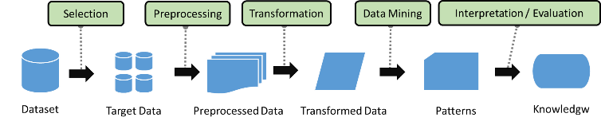
KDD method

Slide 4

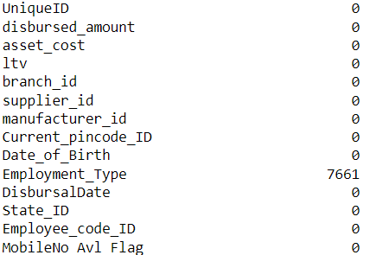
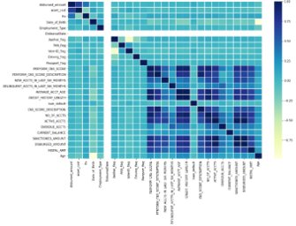
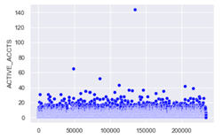
Data cleaning
Data Shape
Missing Value
Correlation
Outlier

Slide 5

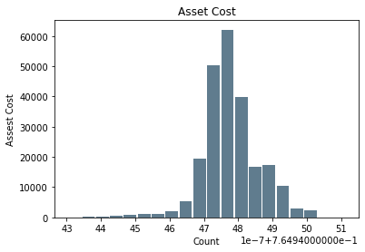

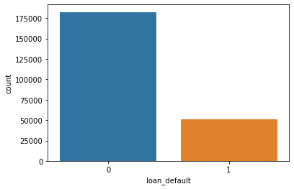
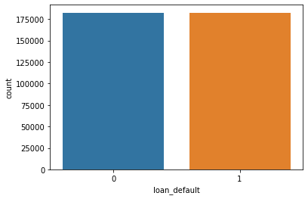
Data Transformation
Boxcox
Date to Age conversion
BoxCox for standard distribution
SMOTE for balancing the Dataset
set
SMOTE

Slide 6
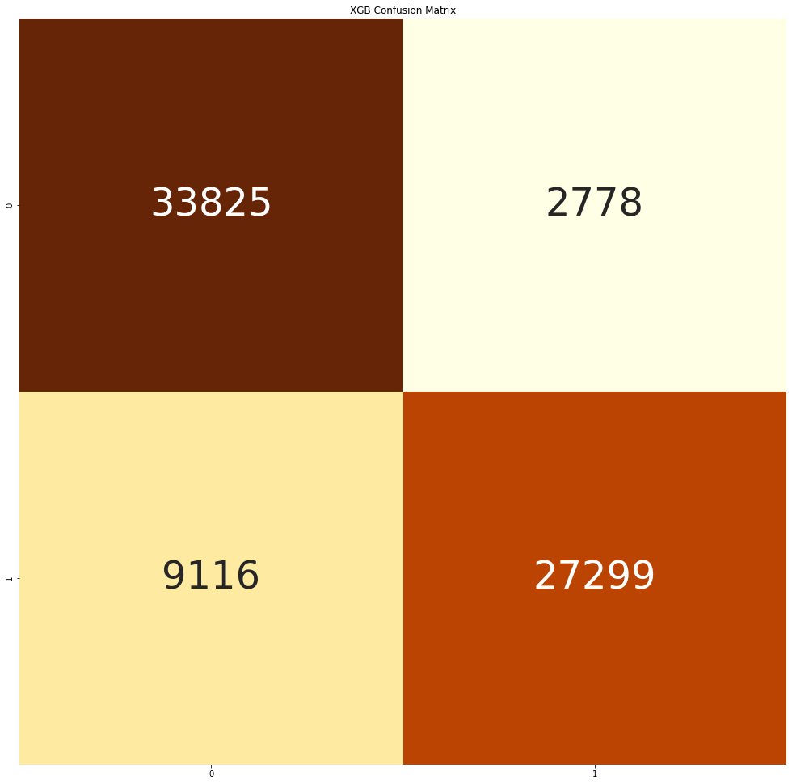
Evaluation
Model Accuracy 83.71 % and precision 90.76%
92.41 % non-defaulters and 74.96% defaulters correctly classified

Slide 7

Business Value
Two Major Business Goals are Achieved.:
Speed Up and smoothen the process of non-defaulters.
Trace down possible defaulters and carry out thorough and in-depth background checks before any further loan processing.

